Slide 1

Nuclear Reactions vs. Normal Chemical Changes
Nuclear reactions- reactions that take place inside the nucleus of an atom
CHEMICAL REACTIONS | NUCLEAR REACTIONS
Bonds are broken and formed | Nuclei emit particles and/or rays
Atoms remain unchanged, only rearranged 2H₂ + O₂ → 2H₂O | Atoms are changed into other atoms of different elements
Involve valence electrons | Involves the nucleus, P⁺, N⁰, e-
Small energy changes | large energy changes (BINDING Energy)
Rate influenced by conc, temp., pressure and catalyst | Not affected by those

Slide 2
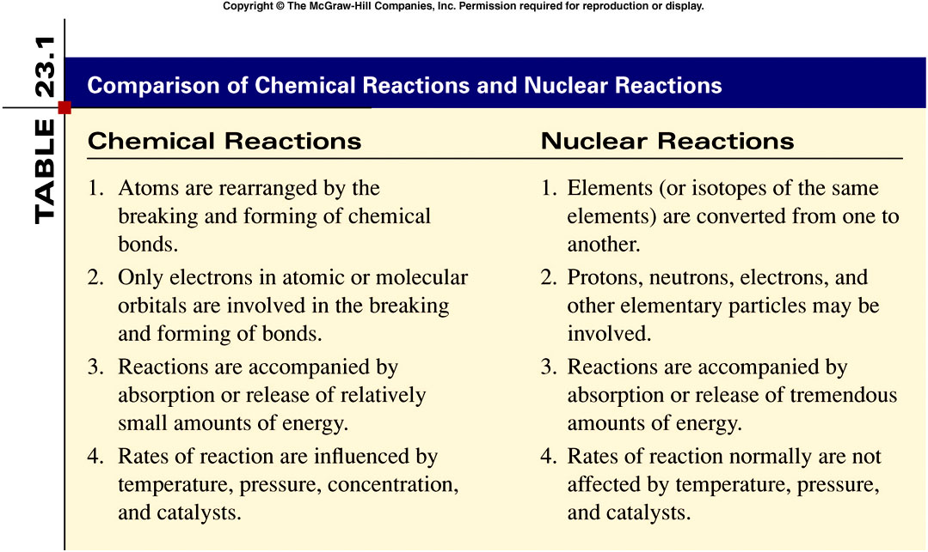
23.1

Slide 3
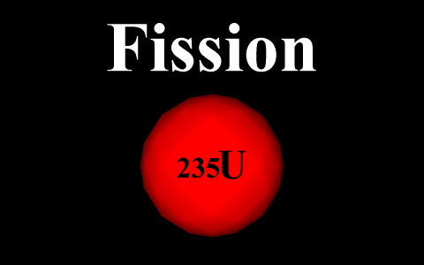
Nuclear Fission
In nuclear fission, a very heavy nucleus splits into more-stable nuclei of intermediate mass.
Enormous amounts of energy are released.
Nuclear fission can occur spontaneously or when nuclei are bombarded by particles.

Slide 4
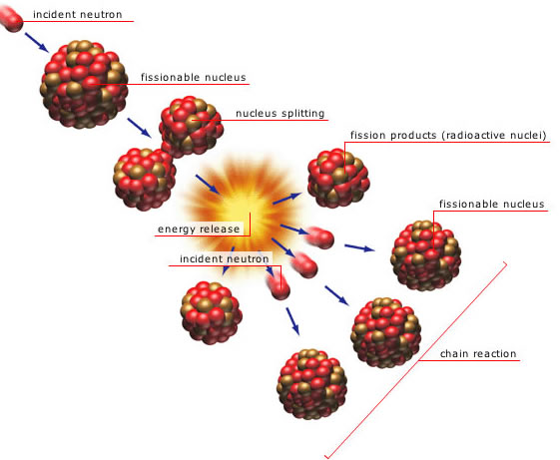
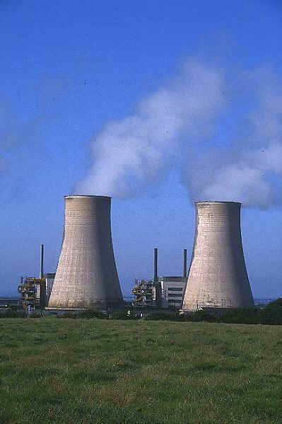
A chain reaction is a reaction in which the material that starts the reaction is also one of the products and can start another reaction.
The minimum amount of nuclide that provides the number of neutrons needed to sustain a chain reaction is called the critical mass.
Nuclear reactors use controlled-fission chain reactions to produce energy and radioactive nuclides.

Slide 5
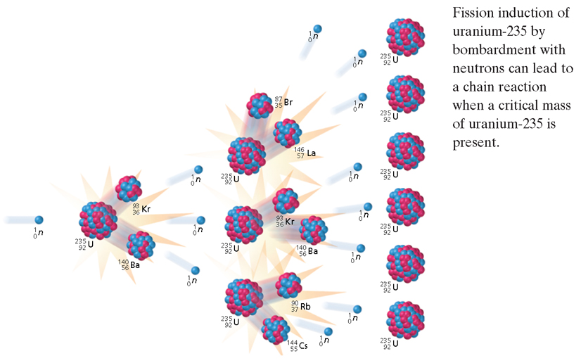
Nuclear Chain Reaction

Slide 6

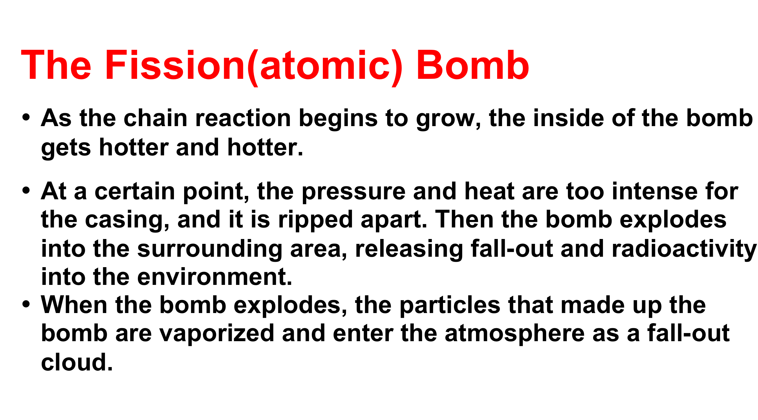
Atomic Bombs
This is what happens in an atomic bomb.
A fission bomb uses an uncontrolled nuclear fission chain reaction to release an enormous amount of energy in a small amount of time.

Slide 7
Using Radioisotopes
Since decay occurs at a predictable rate, we can use the ratio of decayed to undecayed isotopes to…
Determine the age of Organic Matter with Carbon – 14 (Up to 30,000 yrs)
Determine the age of Rocks (and therefore other earth structures) with Uranium – 238 (Millions of yrs.)

Slide 8
More uses for radioisotopes
Tracers used to detect structure and function of organs (thyroid, gall bladder, GI tract, etc…)
Can also be used to track movement of silt in rivers and nutrient uptake in plants.
Cancer treatment
Food preservation
Sensors in Smoke Detectors
Starters in Fluorescent lamps
Nuclear fuel for power plants

Slide 9
Biological Effects of Radiation
Destruction of tissue especially blood and lymph which cells multiply rapidly.
Causes various cancers.
Direct damage to an organism is called Somatic Damage.
Damage that affects reproductive cells is called Genetic Damage. This leads to birth defects in offspring.

Slide 10
Nuclear Reactions
Reactions that occur
naturally as nuclei
strive to be stable.

Slide 11
ISOTOPES
Nuclei with the same atomic number but different mass numbers are called isotopes.
Examples:
Isotope : ₄Be⁷ ; ₄Be⁹ ; ₄Be¹⁰
Isotope : ₁₂Mg²⁴ ; ₁₂Mg²⁵ ; ₁₂Mg²⁶
Isotope : ₂₀Ca⁴⁰ ; ₂₀Ca⁴¹ ; ₂₀Ca⁴² ; ₂₀Ca⁴³ ; ₂₀Ca⁴⁴ ; ₂₀Ca⁴⁵ ; ₂₀Ca⁴⁶ ; ₂₀Ca⁴⁷ ;
₂₀Ca⁴⁸
Isotope : ₃₈Sr⁸² ; ₃₈Sr⁸³ ; ₃₈Sr⁸⁴ ; ₃₈Sr⁸⁵ ; ₃₈Sr⁸⁶ ; ₃₈Sr⁸⁷ ; ₃₈Sr⁸⁸ ; ₃₈Sr⁸⁹ ;
₃₈Sr⁹⁰
Isotope : ₅₆Ba¹³⁰ ; ₅₆Ba¹³² ; ₅₆Ba¹³³ ; ₅₆Ba¹³⁴ ; ₅₆Ba¹³⁵ ; ₅₆Ba¹³⁶ ; ₅₆Ba¹³⁷ ;
₅₆Ba¹³⁸

Slide 12
ISOTONES
Nuclei with the same nutron number but different proton and mass numbers are called isotones.
Examples : 31 P 15 with 32 S 16

Slide 13
ISOBARS
Nuclei with the same mass number but different atomic numbers are called isobars
Examples : ¹²C₆ with ¹² C ₇

Slide 14
Example Problems
The half-life of technetium is 6.00 hours. What mass of Tc-99 remains from a 10.0 gram sample after 24.0 hours.
  Since 24.0 hours is 4 half-life cycles, the original 10.0 gram sample is divided four times.
  Final Mass = Total Mass
  2^{n}
  10.0 g = 10.0g = 0.625 g Tc-99 remain
  2⁴ 16
A 50.0g sample of N-16 decays to 12.5g in 14.4s. What is its half-life?
  Half-Life = Total Time
  n
        Half-Life = 14.4s
        2
        Half-Life = 7.2s
50.0g 1 half = 25.0g 2 half = 12.5 g

